Slide 1
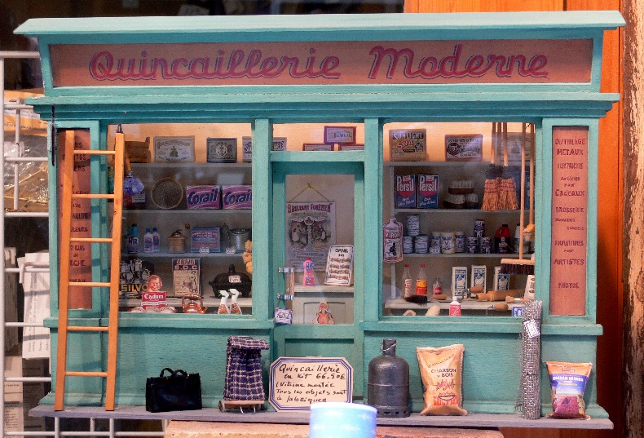

What are brick and click organisations?

Slide 2
What are they?
Bricks
Clicks
Bricks and Clicks
Can we think of an example of each?

Slide 3
Which is best
What are the benefits of a brick organisation?
What are the benefits of a click organisation?
Why would a company chose to be a brick and click company?

Slide 4
Online advertising
A brick organisation is easy to advertise as you have passing trade on the high street plus a shop to direct customers to.
So how can click organisations advertise themselves?

Slide 5
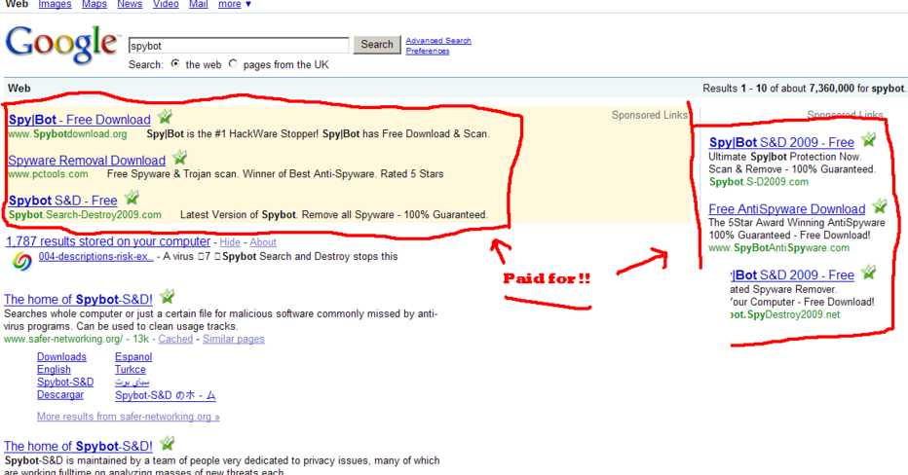
Paying for results

Slide 6
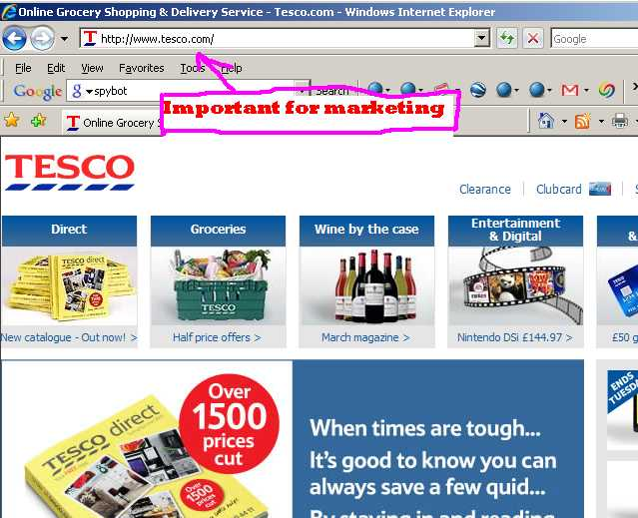

Slide 7
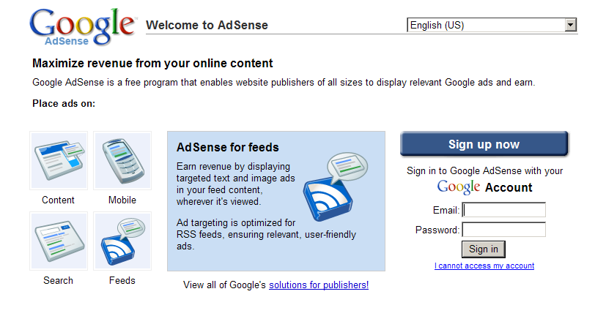
This …

Slide 8
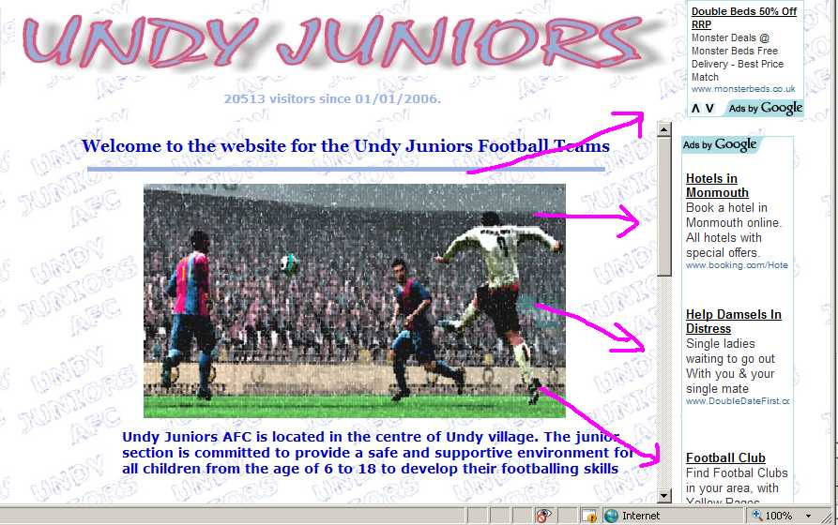
…. gets you this

Slide 9
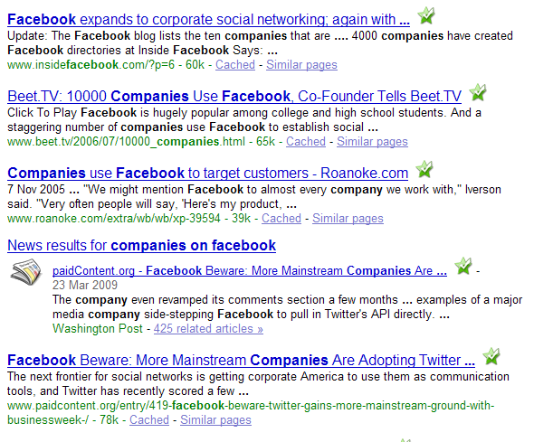

Slide 10
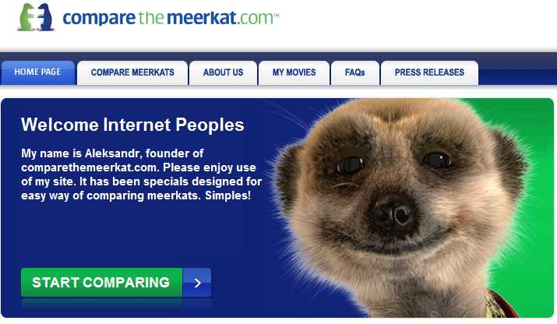
Telly ?

Slide 11
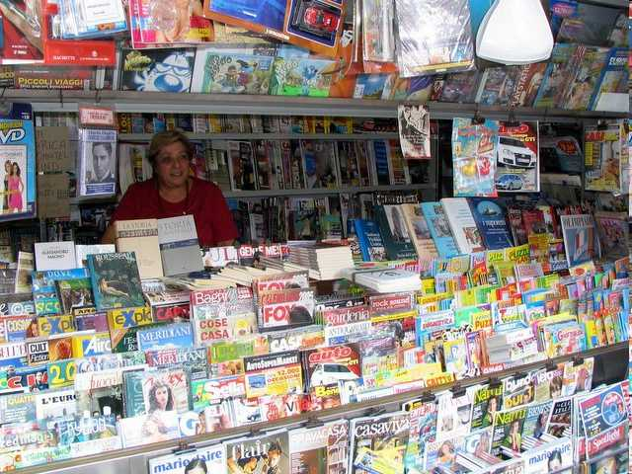
And what about traditional print media ?

Slide 12
Individual Activity
Describe and recommend methods to promote an e-commerce system
Use a chosen organisatation to help you demonstrate this and use print screens to annotate your work.

